Slide 1
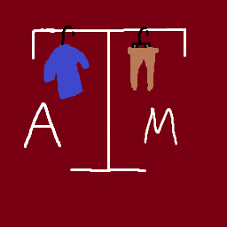

Campus Closet
Members: Hunter Pearson, James Nolan, Nitin Pendekanti, Rishabh Prasad, Jack Sanchez, Ethan Langford, Preston Bied
Sponsor: Teamup and Steven Asher
Professor: Dr. Philip Ritchey

Slide 2
Introduction

Slide 3
Client and Background - Teamup (Apps for Good)
Apps for Good are real-world projects developed by college students
Students get real world experience while improving their technical skills
Our team Campus Closet worked collaboratively worked with Steven Asher of team up

Slide 4
Problem Statement
College students often struggle to afford essential clothing like professional attire and daily wear due to high tuition and living costs.
This financial hardship can negatively impact student participation, dignity, and educational outcomes.
Traditional donation bins are inefficient and lack a direct connection between students in need and donors.

Slide 5
Intended Audience, Use, and Scope
Audience: The main audience for Campus Closet are students in need of clothing assistance and community members who can provide donated items
Use: College students struggle to afford essential clothing, hindering their participation and well-being can have a platform to positively impact them
Scope:
Focuses on a single campus community
Allow students to browse donations, claim items, and connect with vetted donors for pickups.
Filters, claim functionality, chat messaging, and maps

Slide 6
Implementation

Slide 7
Design Decisions
Google OAuth over internal password management
Due to security Concerns
Password management easier if no passwords managed
Only registered students can receive items
Prevent unauthorized individuals from receiving clothing
Narrows target market to only college students
Basic UI
Rather focus on functionality rather than style
Website is functional but not easy to navigate
Not especially intuitive design, but simple once understood

Slide 8
User Flow - Student
The student can:
View Items and the donor’s availability
Request the item
Chat with donor
Review the donor

Slide 9
User Flow - Donor
The donor can:
Upload Items
Create time slot availability
Chat with the student requesting the item
Confirm the request has been completed

Slide 10
DEMO

Slide 11
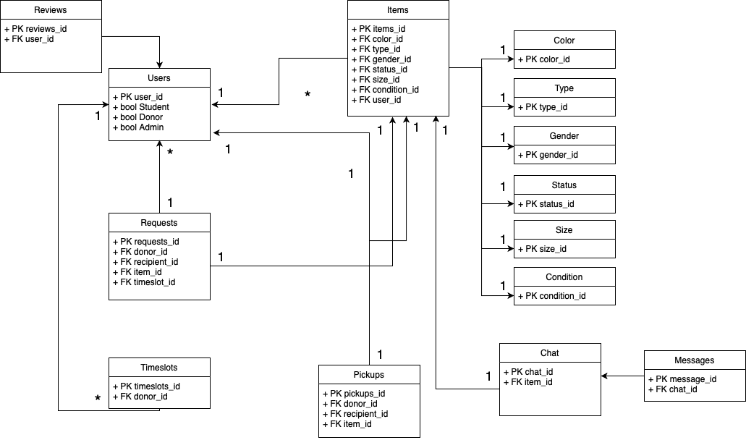
Entity Relationship Diagram of Campus Closet

Slide 12
Results

Slide 13
Challenges/Lessons learned
Challenges:
JavaScript testing
Cucumber issues
Javascript buttons
Only use rails buttons
Overall styling and navigation
Inexperienced and hard to determine success level

Slide 14
BDD/TDD
Testing Required for all stories
Rspec and Cucumber
Achieved combined test coverage of 100%
Improved development process through effective usage of BDD/TDD - ensured all features worked correctly
Difficult to stick to in the beginning but fundamental to effective software development

Slide 15
Future Improvements
Donors should be able to accept or decline item requests
Currently only just automatically makes the item request and time slot is reserved
Security Improvements
Various pages are not able to be directly accessed
But can be accessed through direct URL
Data Deletion
Foreign Keys prevent various pieces of data from being deleted
Including user accounts
Necessary for user privacy concern

